Slide 1
Prototype lab flow by Matheus Almeida

Slide 2
Introduction
Main goals:
Allows student to order equipment from parts crib and prototype lab through the app
Allows lab operator to have a better control with QR codes
Save time and efficiency

Slide 3
Budget
Project budget $150
Raspberry pi 3 starter kit - $101.69
Logitech Webcam c170 - $34.61
Total – $136.30

Slide 4
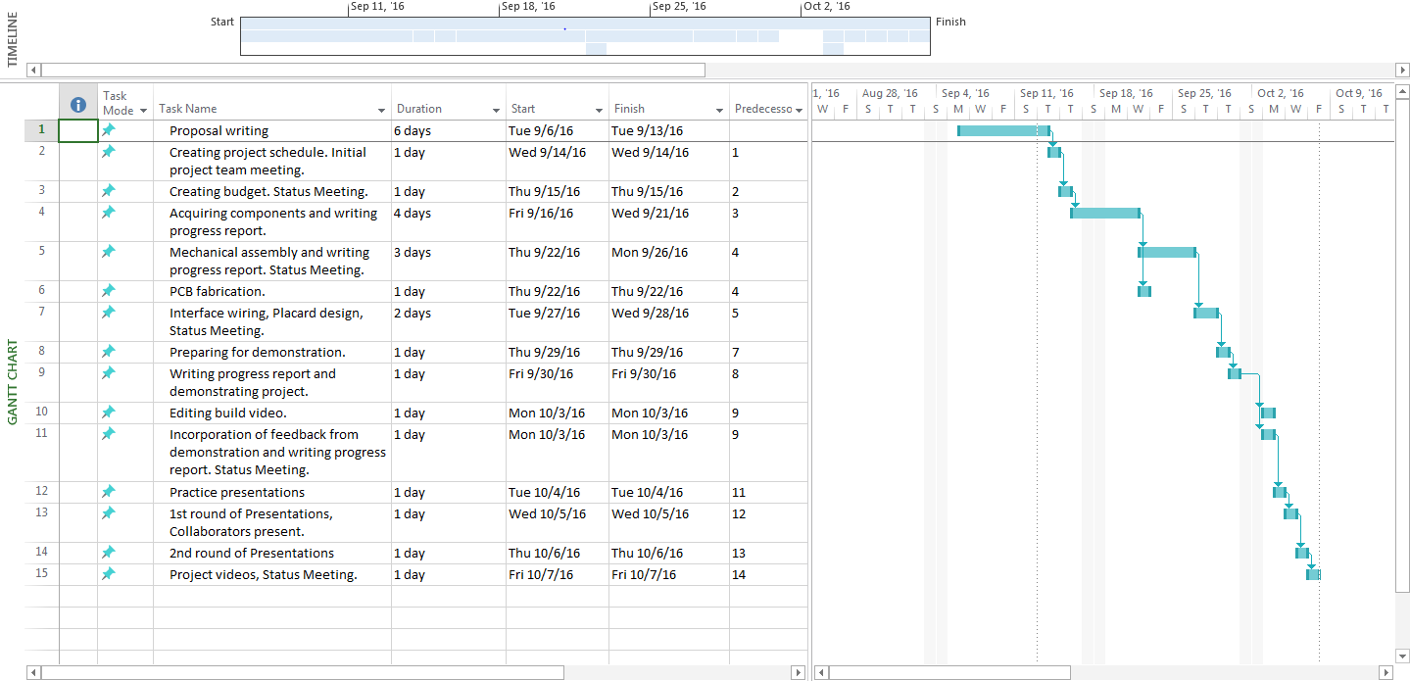
Schedule

Slide 5

Build Video

Slide 6
Knowledge utilized from previous courses
SQL for our database
Programming techniques learned in JAVA
TECH 150 - Electronic devices and circuits
Unix Internals

